Slide 1

Braven MAPD (PPO) Plan
Township of Long Beach
Effective January 1, 2026
This Document is Proprietary and Confidential - Do Not Release Without Permission

Slide 2
Your Braven Medicare Group (PPO) Plan
    When Your Braven Health journey begins…
    Show providers only your Braven Medicare Group (PPO) plan card.
    Welcome kit including all the details we will discuss today
    All Braven Medicare Group (PPO) members will be enrolled in a single policy.
    (HW + both Medicare Eligible = 2 MAPD single policies)
    All other family members currently enrolled who are not eligible for Medicare, will remain in their current plan.
        Leave behinds.
    You may only be enrolled in one Medicare Advantage plan at a time.
      Enrolling in another MA or Part D plan will automatically term this enrollment

Slide 3

What is
?

Slide 4



We are Braven Health
Braven Health combines a partnership you can trust to help you manage your health care
Horizon Blue Cross Blue Shield of New Jersey brings nearly 90 years of experience working to clear a path for members to get the care they need.
Hackensack Meridian Health and RWJBarnabas Health are two of New Jersey’s largest, most comprehensive health systems and are included in our fast growing, extensive network.
Notes:
Braven Health is a NJ based health insurance company that offers Medicare Advantage plans. It was created as a joint venture between Horizon BCBSNJ, Hackensack Meridian Health and RWJBarnabas Health who are 2 of NJ’s largest healthcare systems.
Joined together we are able to provide more affordable Medicare Advantage policies, which are regulated by the Centers of Medicare and Medicaid services (also known as CMS), and can offer unique packaged benefits for employers to offer their retirees like you.

Slide 5
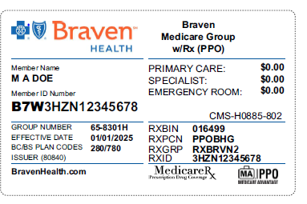
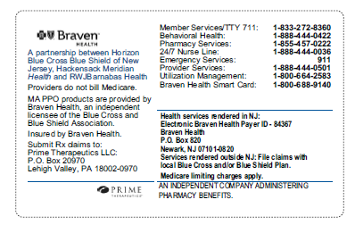
Member Identification Card
Notes:
Here you will see an example of your Braven Health member ID card.
This is going to be the only ID card you will need to show you providers and pharmacies for all services. This is very important in order for providers to bill their services correctly, so you don’t have any claim issues. If they bill Traditional Medicare, they will deny your claim because your Traditional Medicare parts A & B are now built into this Braven plan for you. Braven will become your primary and only payer of claims. Now at any point, if/when you are not longer enrolled in this Braven plan, your Traditional Medicare coverage will automatically become your primary coverage again. You do not lose your Medicare coverage while in this plan… you just don’t need to use it because it’s all built into one simple plan for you.
We are working closely with the Township and our Marsh McLennan partners to ensure you receive your ID cards prior to Jan 1st, but you will also receive an acknowledgement letter and instructions on how to register on the Braven Health portal. That portal allows you to do many things like access your ID card, view claims and so much more.

Slide 6
Medical
 | Braven Medicare Group (PPO)
PLAN COVERAGE | In-Network | Out-of-Network
In-and-out of Network | 100% coverage
Deductible | $0
PCP Visit / Specialist Visit | 100% coverage
Annual Physical Exam | 100% coverage
Private Duty Nursing | 100% coverage
Acupuncture (Pain Management) | 100% coverage
Emergency Care Copay (covered worldwide) | 100% coverage
Inpatient Hospital | 100% coverage
Ambulatory Surgical Center | 100% coverage
Outpatient Hospital | 100% coverage
Ambulance | 100% coverage
Notes:
Be cautious not to confuse this plan with one you may see on a commercial or any websites. This isn’t anything like what your neighbor or friend might have out there on their own. This Braven MAPD policy includes many unique advantages specific to retirees and dependents of this group.

Slide 7
Rx
 | Prescription Coverage
Retail copayment
30 Day Supply
Preferred Generic -$6
Generic-$6
Preferred Brand-$12
Non-Preferred Brand -$24
Specialty Tier-$24
Mail order copayment
90 Day Supply
Preferred Generic -$5
Generic-$5
Preferred Brand-$18
Non-Preferred Brand -$30
Specialty- Not Applicable
Deductible-$0
TrOOP $1,351
Prime Therapeutics administers the pharmacy benefits and network for our Part D plans.
In Network mail-order pharmacies include:
Express Scripts Home Delivery, Walgreens Mail Service, Amazon Mail Order
To download your Formulary Drug List, visit MyPrime.com

Slide 8

$0 Cost Share Benefits
Chiropractor Visits
Skilled Nursing Facility Benefits
Physical Therapy,
Occupational Therapy &
Speech Therapy Visits
Inpatient Mental Health Benefits
8

Slide 9

Hearing Benefits
Covered benefits include:
$0 copayment
routine hearing exam
hearing aid evaluation/fitting
$0 copayment
Up to $1,250 every year
for hearing aids

Slide 10

Vision Benefits
Covered benefits include:
for routine annual eye exams
$0 copayment
for eyeglasses or contact lenses after cataract surgery
$0 copayment
reimbursement every year (max combined with contact lenses) for eyewear or eyeglasses not associated with cataract surgery
Up to $100
10

Slide 11
Large Network
  National coverage with no referrals.
  All medically necessary claims covered in full.
  No balance billing.
  No member liability.
  Providers who have completely opted out of Medicare, will not be covered.
Notes:
The extensive network includes the Blue Cross Blue Sheild MA PPO Shared Network of Providers across all states.
This plan design with 100% coverage both in and out of network allows you the ability to utilize all Traditional Medicare-participating providers in the country, with no referrals.
There is no balance billing or member liability when medically necessary.
Now, it’s important to remember, while this plan allows you the freedom of using any provider in the country, you cannot utilize a provider that has completely opted out of Traditional Medicare. Opting-out is extremely rare, but it can happen. So the question you should ask your provider is, “Do you accept Traditional Medicare Patients?” and if the answer is no, then you may want to consider seeing another provider. Braven Health can not spend federal dollars on a provider that has opted out or has been excluded by Medicare, especially if due to fraud.
One sign of comfort is, if your provider was being paid by the plan you have today, then it means they most likely participate with Medicare, and you are covered 100% on this Braven MAPD plan.

Slide 12
How to find a doctor or specialist
To find a participating doctor in our network:
  Search our Doctor & Hospital Finder at BravenHealth.com/find-doctor.
  Call Member Services at 1-833-272-8360 (TTY 711).
Braven Health PPO members have extended network access outside of New Jersey, in 48* participating states.
  All Traditional Medicare providers in the USA, whether they accept assignment or not, can be searched on Traditional Medicare’s site at Find Healthcare Providers: Compare Care Near You | Medicare
Notes:
Now it is certainly easier for you if you utilize Braven Participating providers here in NJ or providers that participate in your Local Blue Cross Blue Sheild MA PPO Plans because they will do things for you like submit your claims to us or obtain prior authorizations and things like that. An out of network provider will be covered in full, but we cannot force them to do those things for you.
To find a participating doctor in or outside of NJ , you could use the Search our Doctor & Hospital Finder online at BravenHealth.com/find-doctor.
All Traditional Medicare providers in the USA, whether they accept assignment or not, can be searched on Traditional Medicare’s site at Find Healthcare Providers: Compare Care Near You | Medicare
If you have any issues finding a provider, please feel free to call Member services after your effective date. Their number will be on the back of your ID card and they will be able happy to assist.
But remember, if your provider does not participate in the Braven or your local BCBS MA PPO network, that’s ok! If they participate in Traditional Medicare, whether they agree with Medicare’s payment amounts or not, your benefits are covered in full.

Slide 13
Extra Savings and Advantages

Slide 14
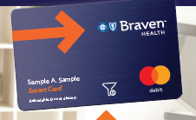
BRAVEN HEALTH &more CARD
Eyewear Benefit | $100 Every 2 Years
Fitness Benefit | $200 Per Year
Rewards & Incentives | Up to $385 Per Year
Notes:
The Braven Health plan includes a Braven Health &more Card. This card is very similar to any other credit card except you can only use it for certain things and it fills up with money you are rewarded with throughout the year.
You will receive instructions on how to register this card from Braven Health &More.
You will be able to this card for the things like:
Vision Hardware
Fitness Benefit: Health club and boutique studio memberships, Up to four personal training sessions, home fitness, or even fitness equipment
Rewards & Incentives

Slide 15
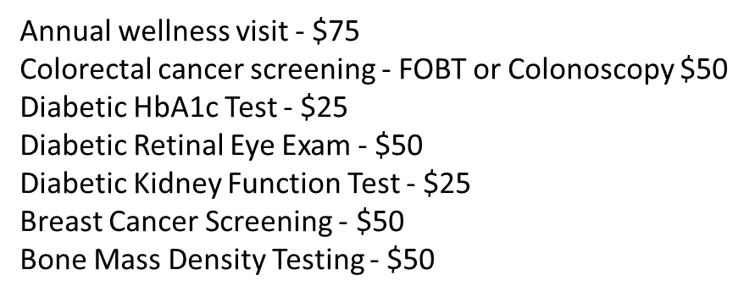
Earn up to $385/year for routine health screenings
Rewards & Incentives
Notes:
So, not only do you pay $0 toward medical services, but Braven Health is also offering to reward you for completing routine health screening. Through the Healthy Journey Rewards Program, Braven members can earn up to $385 per year in rewards for these health screenings.
Annual wellness visit - $75
Colorectal cancer screening - FOBT or Colonoscopy $50
Diabetic HbA1c Test - $25
Diabetic Retinal Eye Exam - $50
Diabetic Kidney Function Test - $25
Breast Cancer Screening - $50
Bone Mass Density Testing - $50
Etc…
All of these screenings total an award of up to $385 per year and can be spent at participating vendors near you. Again, all of these details will be included in your new member packages.

Slide 16
Home-Delivered Meals
    Home Delivered Meals
    After an acute inpatient hospital discharge to your home, you may be eligible to receive up to 28 nutritious meals over a 14-day period (2 meals per day) to help you recover from your illness.
    Home-delivered meals are limited to one occurrence per calendar year. Covers delivery of nutritiously balanced meals specifically for you.
Nutritious Meal Delivery
Notes:
You are eligible for Home-Delivered meals also know as, Mom’s Meals which are Nutritional Meals delivered to your home after a qualifying inpatient hospital discharge. You may be eligible to receive 28 nutritious meals for a 14 day period. This is something that would be coordinated during your hospital or rehabilitation admission for delivery to your home after discharge. It gives you the peace of mind of not having to cook and allows you the ability to just focus on getting better.

Slide 17
Getting the care you need

Slide 18
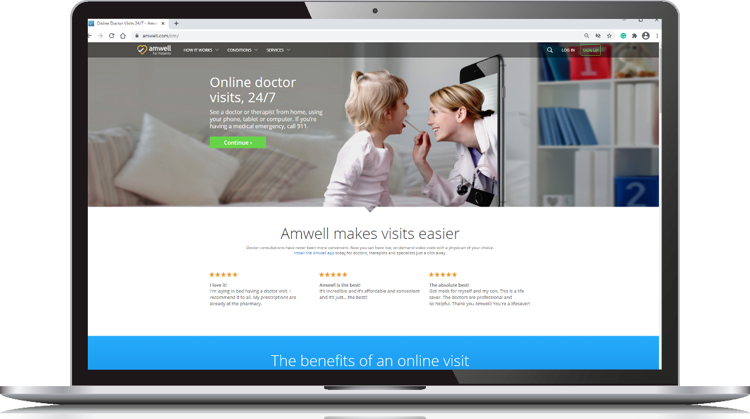
Telehealth – Online doctors and therapists
    Get the care you need safely at home using your phone, tablet or computer – all for $0 with Braven Health’s care online program.
You do not need an appointment for urgent visits.
You do need to schedule an appointment for behavioral health visits (7 a.m. – 11 p.m., 7 days/week)
Access care online by visiting Amwell.com or download the Amwell: Doctor Visits 24/7 App.
You will be asked to create an account and enter the Service Key “Braven”.
Notes:
Another way of getting the care you need, especially since the COVID era , is through our Telehealth care online program which allows you to talk privately with a licensed, board-certified network provider via video or chat, seven days a week, using a web-enabled computer or mobile device – all for a $0 copay.
• You do not need an appointment for urgent telemedicine visits, and an ePrescription will be provided if you need one.
• You do need to schedule an appointment for behavioral health visits (appointments are available between 7 a.m. and 11 p.m., seven days a week).
And you can use this service as often as you like. You get unlimited medical video visits with health care providers from the comfort of your own home OR wherever you are at the time.
You can access this service by visiting Amwell.com or you can access this feature through your Braven app on your phone as well.

Slide 19
Nurse Line
    You also have access to a dedicated Nurse Line.
Get the care
you need – safely from home
    Call the 24/7 Nurse Line toll free, 24 hours a day, seven days a week for:
      Immediate answers to general health questions.
      Access to caring, experienced registered nurses.
    Call 1-888-444-0036 (TTY 711).

Slide 20
Questions?

